Slide 1

IMAGE CAPTIONING
-By Sandipta Subir Khare
Priyanka Biswas
Shinakshi Sankhayan
Gulfairus Kairedenova

Slide 2
AGENDA
Problem Statement
Objective
Tools & Libraries
What is Image Caption
Pros and Cons of Image Captioning
How to do Image Captioning Implementation
Techniques for Image Captioning
Natural Language Processing
NLP Based Techniques
Working of Tokenizer
Data Generator
Caption Generation Process
Deep Learning: Pre-Trained Model
Deep Learning: Xception
Deployment

Slide 3
PROBLEM STATEMENT
Now days, if someone see the image and not able to recognise what image is showing. Then in that Scanerio Image Captioning would help the user to get the final output of the image.
If there is an user with medical conditions like blind and paralysis then they might able to use any technology for recognising the image. Our project Image Captioning with Voice recognition would help the user to get the final output.

Slide 4
OBJECTIVE
Image caption, automatically generating natural language descriptions according to the content observed in an image, is an important part of scene understanding, which combines the knowledge of computer vision and natural language processing. The application of image caption is extensive and significant, for example, the realization of human-computer interaction.

Slide 5
TOOLS & LIBRARIES
TOOLS USED:
Python
LIBRARIES:
Numpy
Pandas
Matplotlib
Keras

Slide 6
WHAT IS IMAGE CAPTION?
Image Captioning is the process of generating textual description of an image. It uses Machine Learning, Deep Learning, Natural Language Processing and Computer Vision to generate the captions. The dataset will be in the form [image → captions]. The dataset consists of input images and their corresponding output captions.

Slide 7
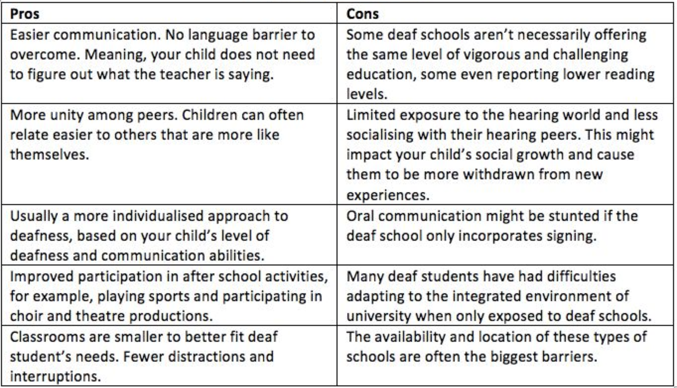
PROS AND CONS OF IMAGE CAPTIONING

Slide 8
HOW TO DO IMAGE CAPTIONING IMPLEMENTATION?

Slide 9
IMPLEMENTATION
The task of image captioning can be divided into two modules logically:
One is an image based model – which extracts the features and nuances out of our image, and
The other is a language based model – which translates the features and objects given by our image based model to a natural sentence.

Slide 10
TECHNIQUES FOR IMAGE CAPTIONING
The techniques which we may use for the image captioning can be broadly divided into two categories:
Deep Learning based techniques and
NLP based techniques.

Slide 11
NATURAL LANGUAGE PROCESSING
Computers don’t understand English words, for computers, we will have to represent them with numbers. So, we have map each word of the vocabulary with a unique index value. Keras library provides us with the tokenizer function that we will use to create tokens from our vocabulary and save them to a “tokenizer's” pickle file.
Our vocabulary contains 7577 words.
We calculate the maximum length of the descriptions. This is important for deciding the model structure parameters.

Slide 12
NLP BASED TECHNIQUES
This technique combines Computer Vision and Natural Language Processing techniques to create a model that can describe contents of an image into natural language. This technique is useful for
Captioning images on the internet, which helps visually impaired people using a screen reader to describe the contents of an image into words.
Captioning a large database of images to make it easier to search images with description.

Slide 13
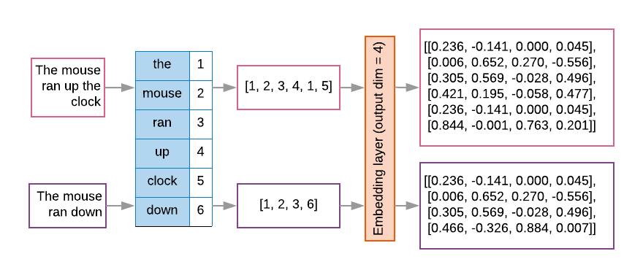
WORKING OF TOKENIZER
Fig 1.1

Slide 14
DATA GENERATOR
We have train our model on 6000 images and each image will contain 2048 length feature vector and caption is also represented as numbers. This amount of data for 6000 images is not possible to hold into memory so we will be using a generator method that will yield batches.
The generator will yield the input and output sequence.
The input to our model is [x1, x2] and the output will be y, where x1 is the 2048 feature vector of that image, x2 is the input text sequence and y is the output text sequence that the model has to predict.

Slide 15
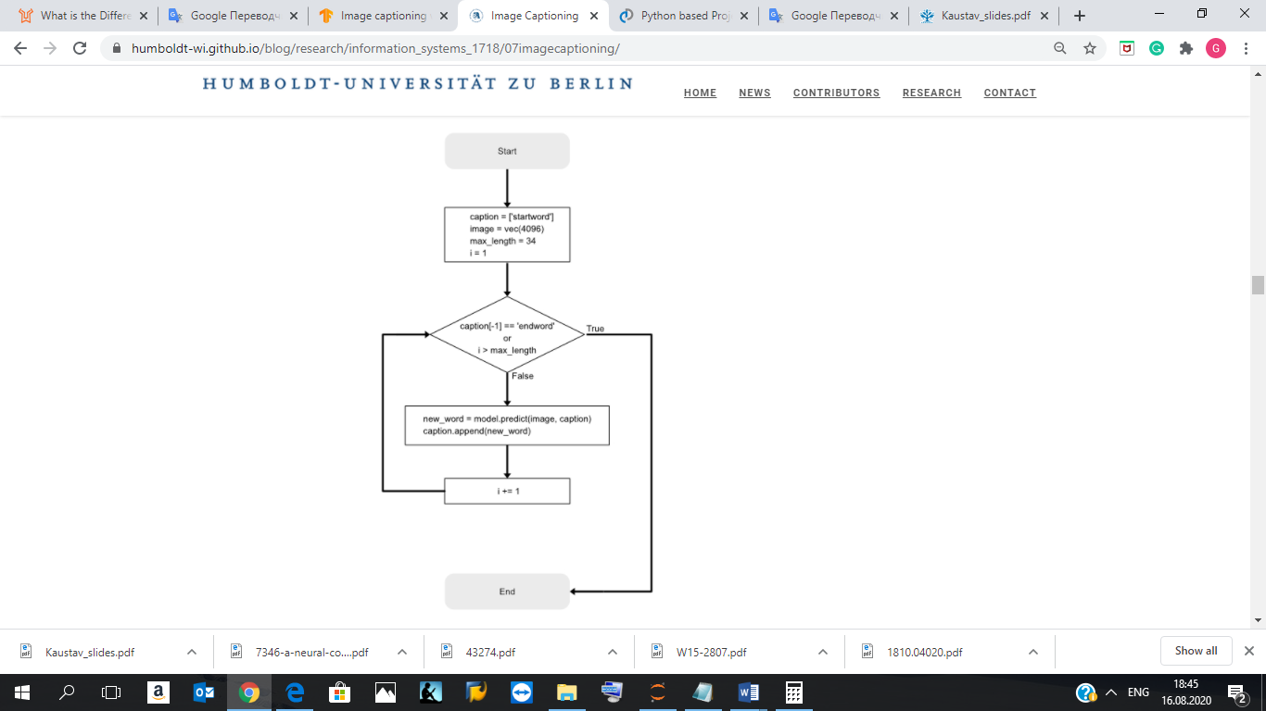
CAPTION GENERATION PROCESS
Fig 1.2

Slide 16
Deep Learning Techniques
In deep learning based techniques, features are learned automatically from training data and they can handle a large and diverse set of images and videos. For example, Convolutional Neural Networks (CNN) are widely used for feature learning, and a classifier such as SoftMax is used for classification. CNN is generally followed by Recurrent Neural Networks (RNN) in order to generate captions.
An embedding layer will handle the textual input, followed by the LSTM layer.
Decoder – By merging the output from the above two layers, we will process by the dense layer to make the final prediction. The final layer will contain the number of nodes equal to our vocabulary size.

Slide 17
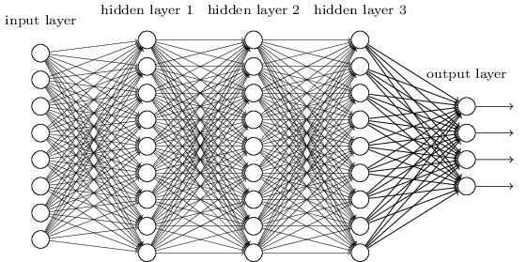
DEEP LEARNING CONVOLUTIONAL NEURAL NETWORK
Fig 1.3

Slide 18
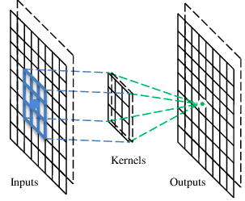
CONVOLUTION LAYER
A CNN is a neural network with some convolutional layers (and some other layers).
A convolutional layer has a number of filters that does convolutional operation
Fig 1.4

Slide 19
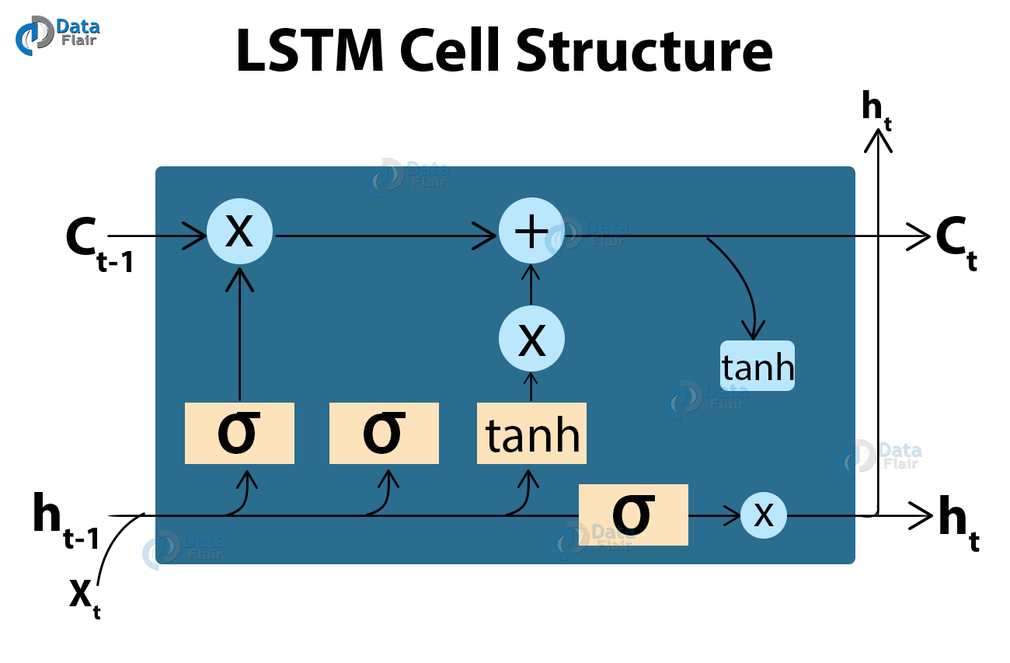
LSTM
LSTM stands for Long short term memory, they are a type of RNN (recurrent neural network) which is well suited for sequence prediction problems. Based on the previous text, we can predict what the next word will be. It has proven itself effective from the traditional RNN by overcoming the limitations of RNN which had short term memory. LSTM can carry out relevant information throughout the processing of inputs and with a forget gate, it discards non-relevant information.
This is what an LSTM cell looks like –
Fig 1.5

Slide 20
EXTRACTING FEATURES
Extracting features from the image CNN: We would use Xception model also to extract features
Xception model: pre-trained model that have been already trained on large datasets and extract the features from these models and use them for our tasks. Xception model has been trained on imagenet dataset that had 1000 different classes to classify. We can directly import this model from the keras.applications . Xception model takes 299*299*3 image size as input. We will remove the last classification layer and get the 2048 feature vector.

Slide 21
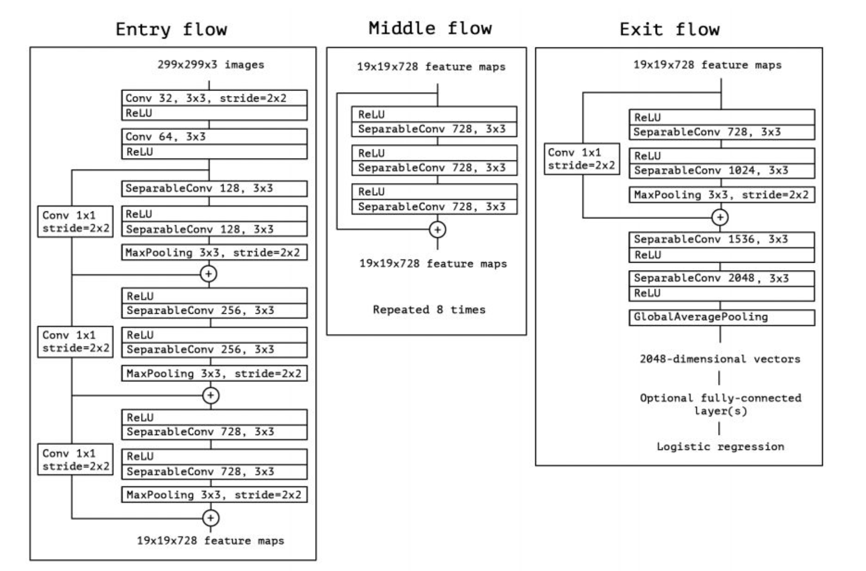
XCEPTION ARCHITECTURE
ARCHITECTURE
The very first module contains conventional convolution layers and they don’t have any DSC ones. They take input tensors of size (-1, 299, 299, 3). The -1 in the first dimension represents the batch size. A negative -1 just denotes that the batch size can be anything. And every convolution layer, both conventional and DSC, is followed by a Batch Normalization layer. The convolutions that have a stride of 2 reduces it by almost half. And the output’s shape is shown by the side which is calculated using the convolution formula that we saw before.
In the middle flow, there are eight such modules, one after the other. The above module is repeated eight times to form the middle flow. All the 8 modules in the middle flow use a stride of 1 and don’t have any pooling layers. Therefore, the spatial size of the tensor that’s passed from the entry flow remains the same. The channel depth remains the same too as all the middle flow modules have 728 filters. And that’s the same as the input’s depth.
The exit flow has just two convolution modules and the second one doesn’t have any skip connection. The second module uses Global Average Pooling, unlike the earlier modules which used Maxpooling. The output vector of the average pooling layer can be fed to a logistic regression layer directly. But we can optionally use intermediate Fully Connected layers too.
Fig 1.6

Slide 22
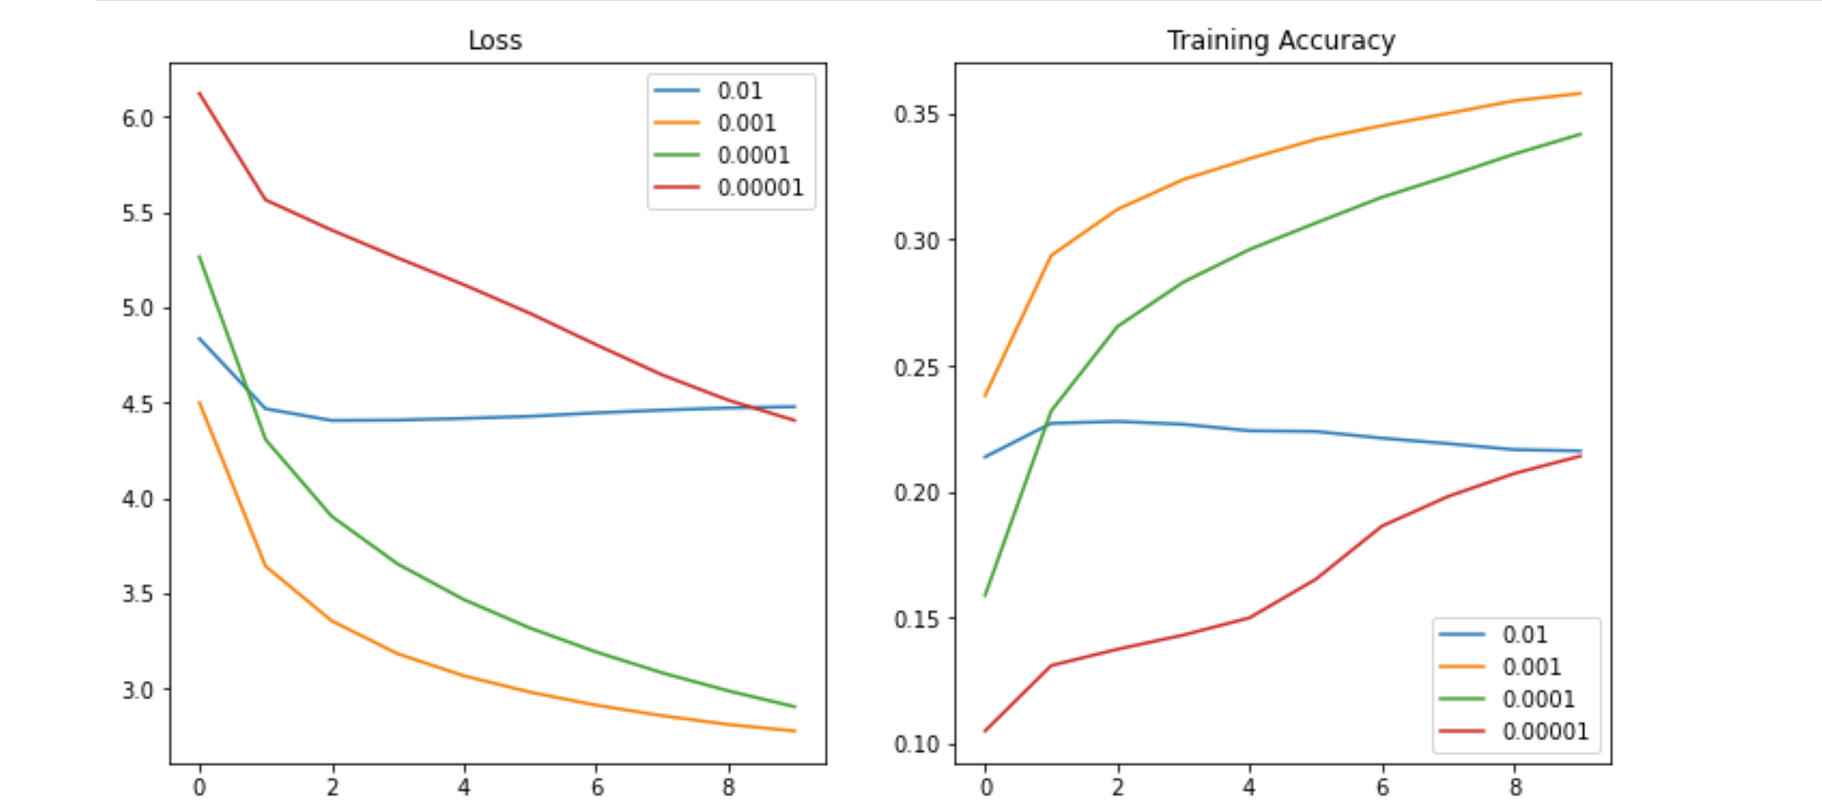
XCEPTION LEARNING RATE

Slide 23
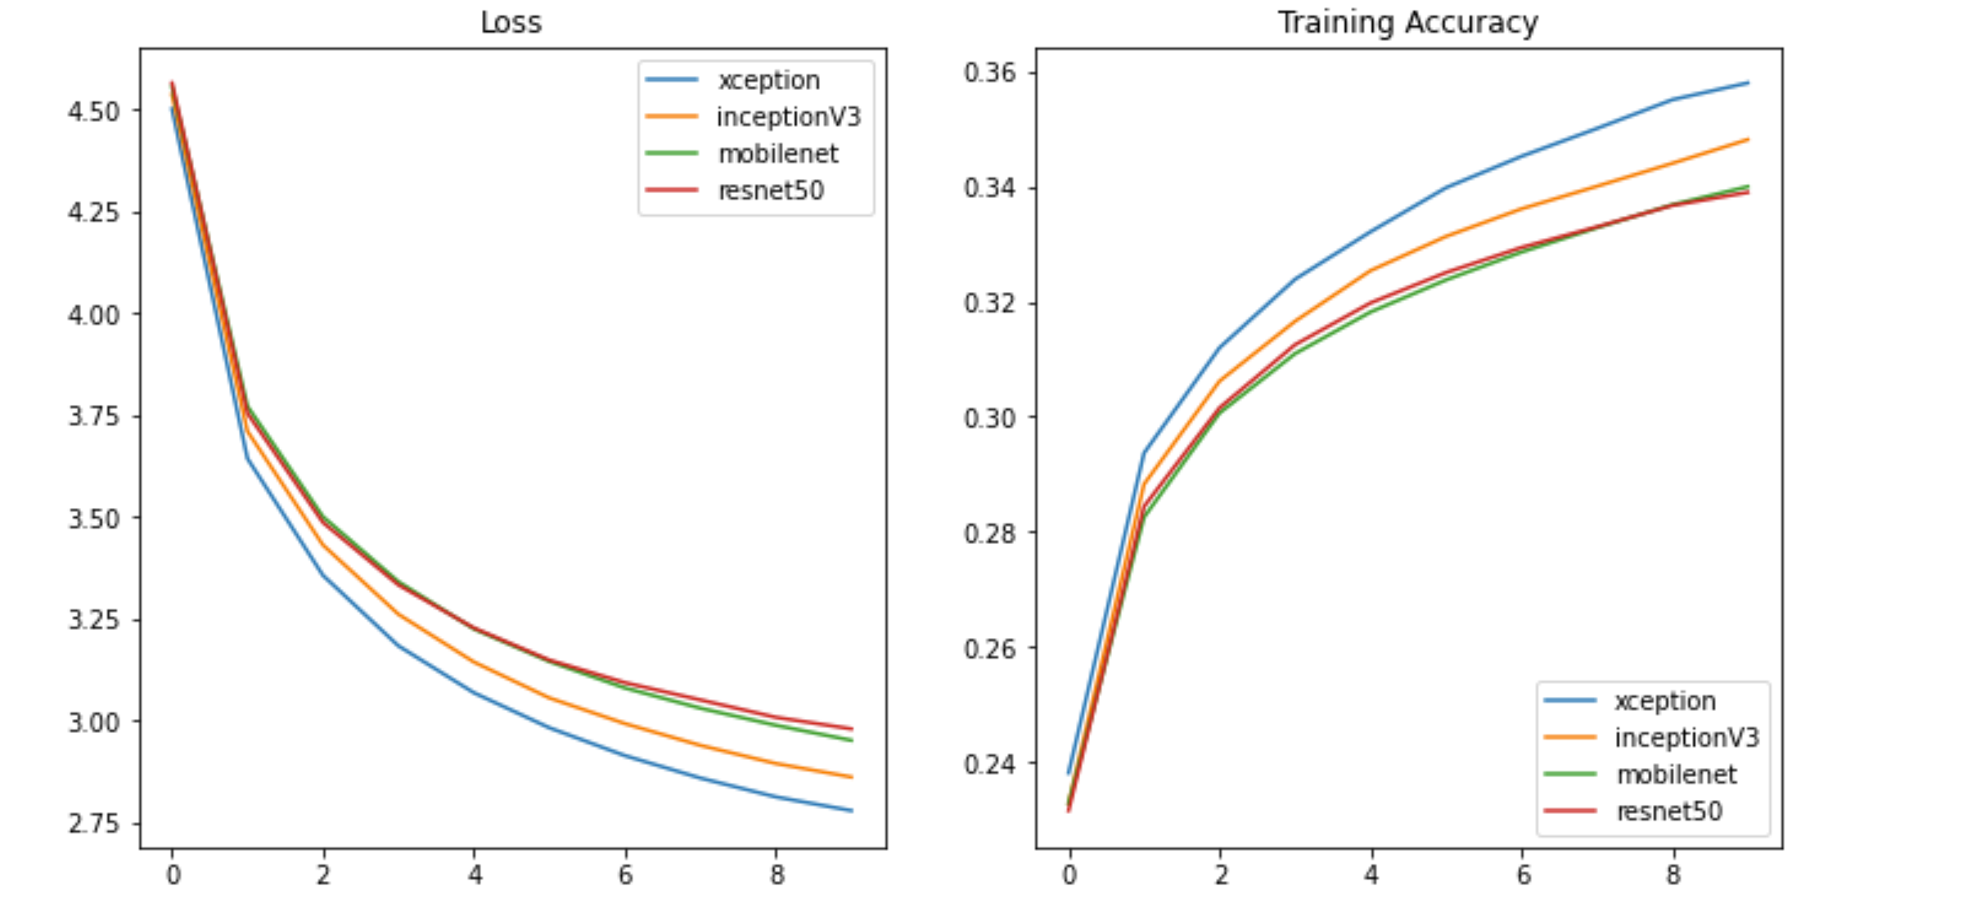
MODEL TRAINING

Slide 24
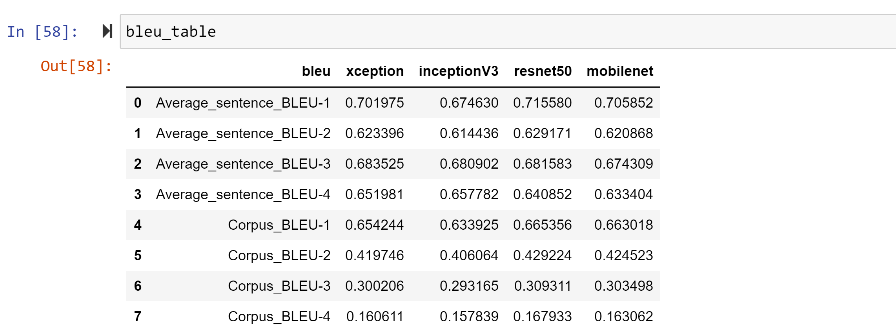
ACCURACY RATE

Slide 25
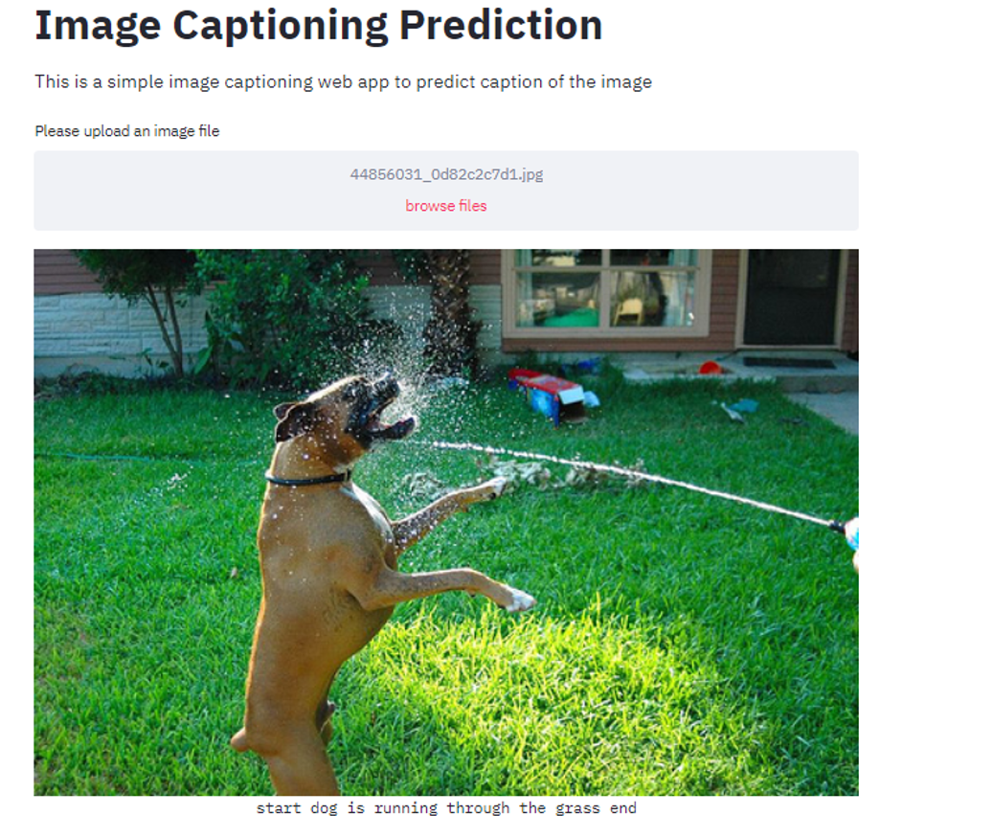
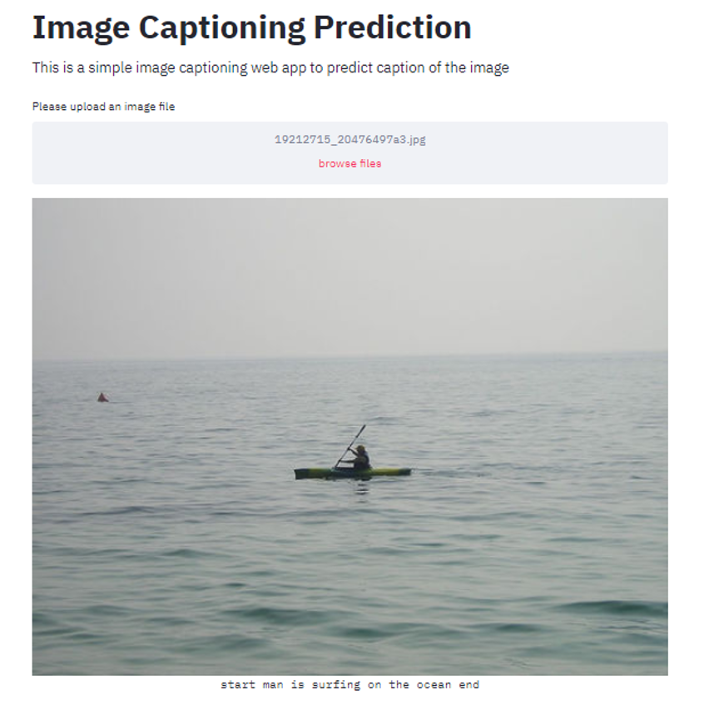
DEPLOYMENT
Fig 1.7
Fig 1.8

Slide 26
THANK YOU

